Slide 1
Chapter 11: Security
If you reveal your secrets to the wind, you should not blame the wind for revealing them to the trees. —Kahlil Gibran

Slide 2
Chapter Outline
What is Security?
Security General Scenario
Tactics for Security
Tactics-Based Questionnaire for Security
Patterns for Security
Summary

Slide 3
What is Security?
Security is a measure of the system’s ability to protect data and information from unauthorized access while still providing access to people and systems that are authorized.
The simplest approach to characterizing security focuses on three characteristics: confidentiality, integrity, and availability (CIA):
Confidentiality is the property that data or services are protected from unauthorized access.
Integrity is the property that data or services are not subject to unauthorized manipulation.
Availability is the property that the system will be available for legitimate use.

Slide 4
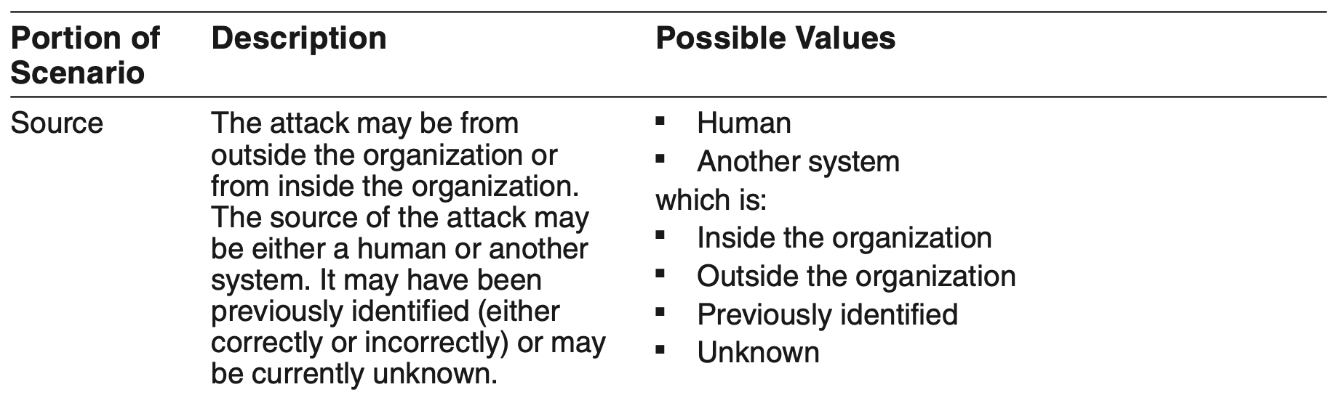
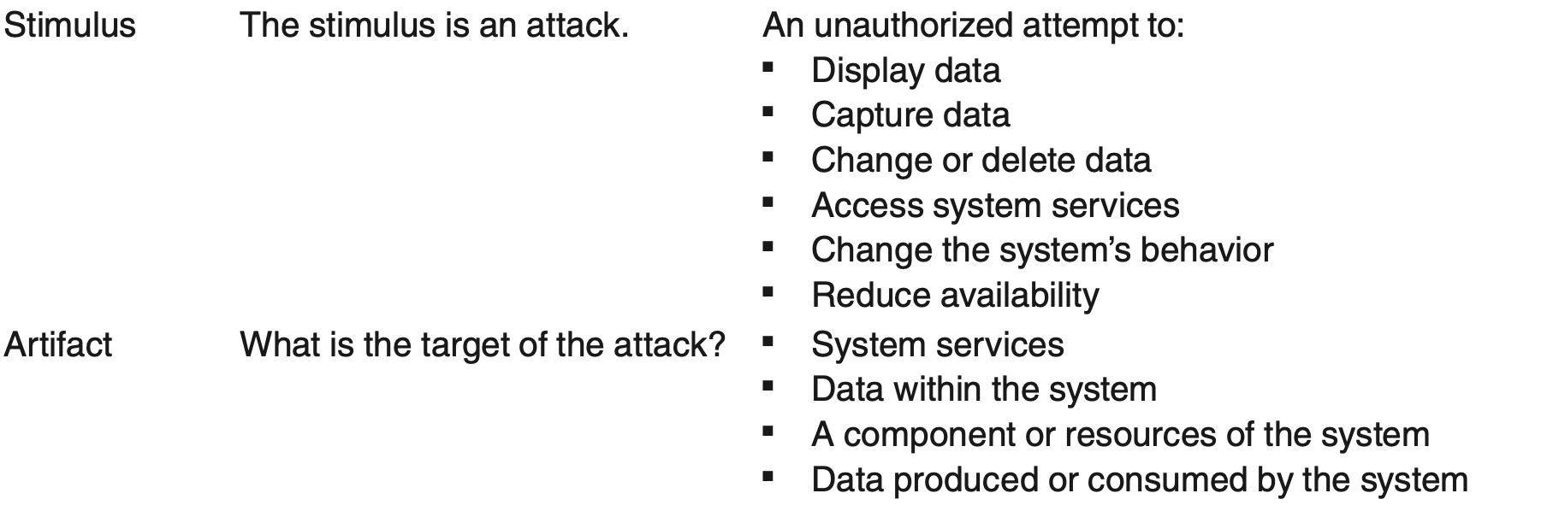
Security General Scenario

Slide 5
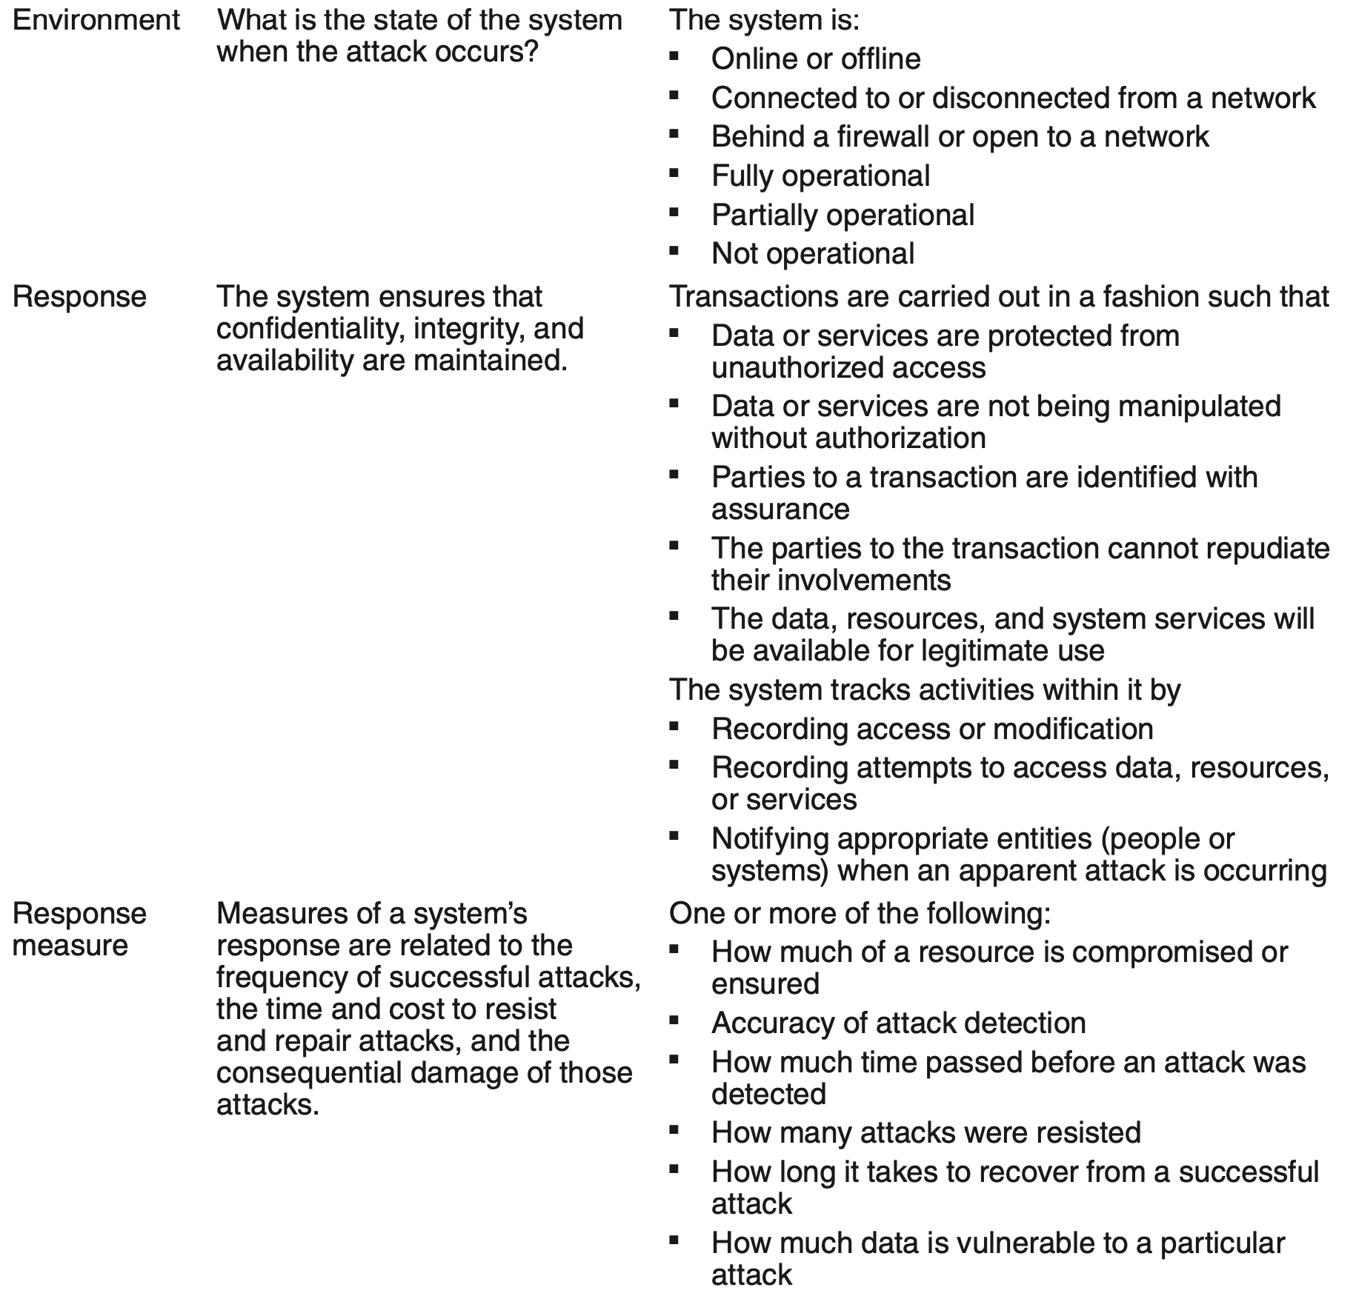
Security General Scenario

Slide 6
Sample Concrete Security Scenario
A disgruntled employee at a remote location attempts to improperly modify the pay rate table during normal operations. The unauthorized access is detected, the system maintains an audit trail, and the correct data is restored within one day.

Slide 7
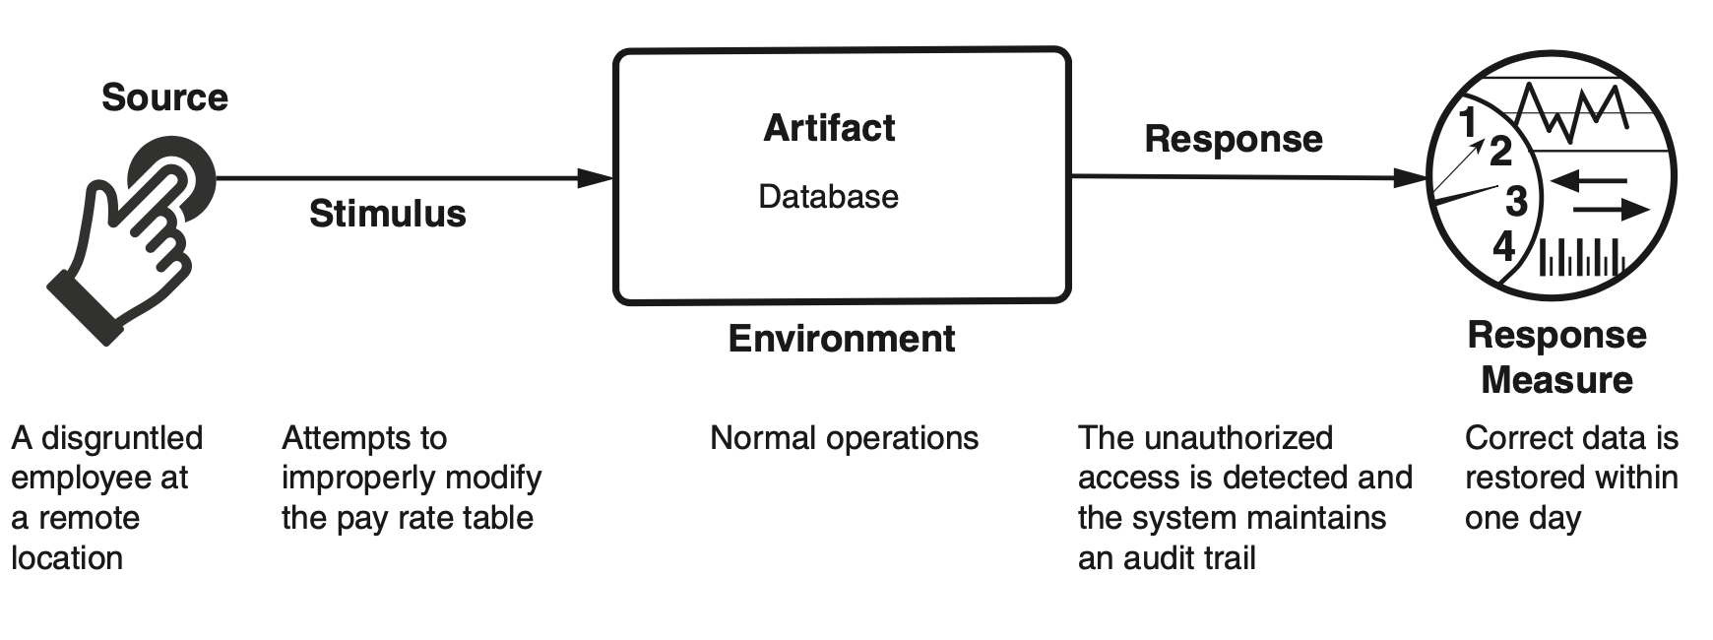
Sample Concrete Security Scenario

Slide 8
Goal of Security Tactics
Secure facilities in the real world permit only limited access to them (e.g., fences and security checkpoints), have means of detecting intruders (e.g., requiring visitors to wear badges), have deterrence mechanisms (e.g., armed guards), have reaction mechanisms (e.g., automatic locking of doors), and have recovery mechanisms (e.g., off-site backup).
These lead to our four categories of tactics: detect, resist, react, and recover.

Slide 9
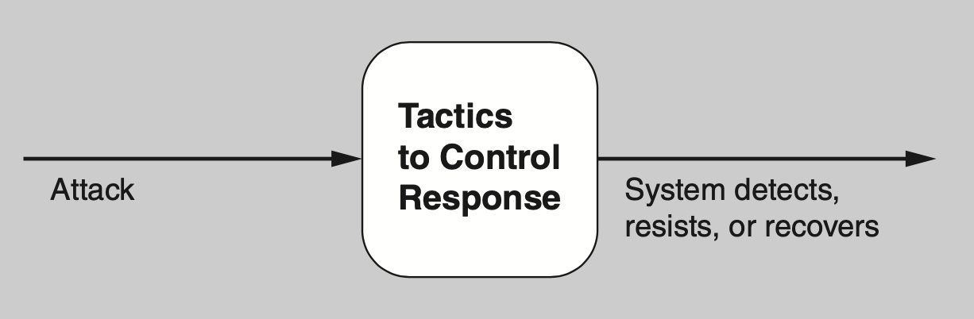
Goal of Security Tactics

Slide 10
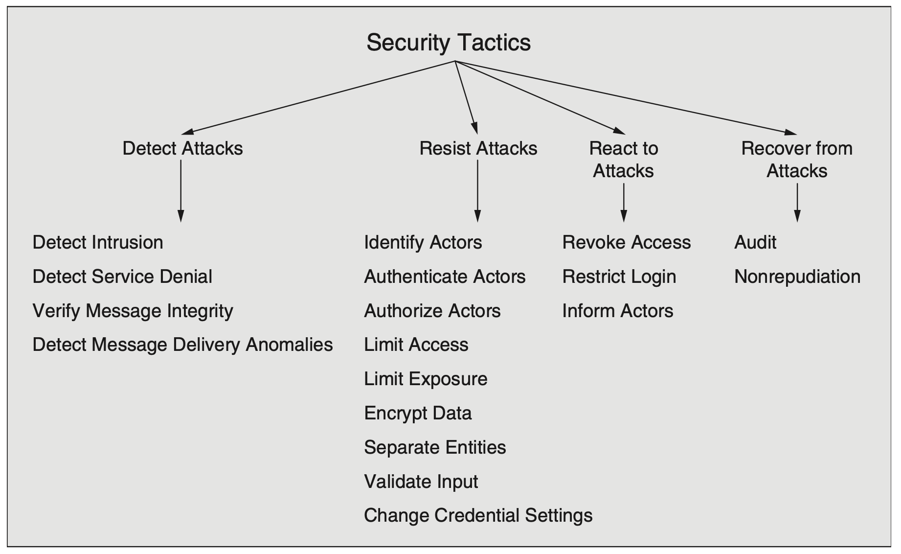
Security Tactics

Slide 11
Detect Attacks
Detect intrusion. This tactic compares network traffic or service request patterns within a system to a set of signatures or known patterns of malicious behavior stored in a database.
Detect service denial. This tactic compares the pattern or signature of network traffic coming into a system to historical profiles of known denial-of-service (DoS) attacks.

Slide 12
Detect Attacks
Verify message integrity. This tactic employs techniques such as checksums or hash values to verify the integrity of messages, resource files, deployment files, and configuration files.
Detect message delivery anomalies. This tactic seeks to detect man-in-the-middle attacks. If message delivery times are normally stable, then by checking the time that it takes to deliver or receive a message, it becomes possible to detect suspicious timing behavior. Similarly, abnormal numbers of connections and disconnections may indicate such an attack.

Slide 13
Resist Attacks
Identify actors. Identifying actors (users or remote computers) focuses on identifying the source of any external input to the system. Users are typically identified through user IDs. Other systems may be “identified” through access codes, IP addresses, protocols, ports, or some other means.
Authenticate actors. Authentication means ensuring that an actor is actually who or what it purports to be. Passwords, one-time passwords, digital certificates, two-factor authentication, and biometric identification provide means for authentication.
Authorize actors. Authorization means ensuring that an authenticated actor has the rights to access and modify either data or services. This mechanism is usually enabled by providing some access control mechanisms within a system.

Slide 14
Resist Attacks
Limit access. This tactic involves limiting access to computer resources. Limiting access might mean restricting the number of access points to resources, or restricting the type of traffic that can go through the access points. Both kinds of limits minimize the attack surface of a system.
Limit exposure. This tactic focuses on minimizing the effects of damage caused by a hostile action. It is a passive defense since it does not proactively prevent attackers from doing harm. Limiting exposure is typically realized by reducing the amount of data or services that can be accessed through a single access point, and hence compromised in a single attack.
Encrypt data. Confidentiality is usually achieved by applying some form of encryption to data and to communication. Encryption provides extra protection to persistently maintained data beyond that available from authorization.

Slide 15
Resist Attacks
Separate entities. Separating different entities limits the scope of an attack. Separation within the system can be done through physical separation on different servers attached to different networks, the use of virtual machines, or an “air gap”—that is, by having no electronic connection between different portions of a system.
Validate input. Cleaning and checking input as it is received by a system, or portion of a system, is an important early line of defense in resisting attacks. This is often implemented by using a security framework or validation class to perform actions such as filtering, canonicalization, and sanitization of input.
Change credential settings. Many systems have default security settings assigned when the system is delivered. Forcing the user to change those settings will prevent attackers from gaining access to the system through settings that may be publicly available.

Slide 16
React to Attacks
Revoke access. If the system or an administrator believes that an attack is under way, then access can be limited to sensitive resources, even for normally legitimate users and uses.
Restrict login. Repeated failed login attempts may indicate a potential attack. Many systems limit access from a particular computer if there are repeated failed attempts to access an account from that computer.
Inform actors. Ongoing attacks may require action by operators, other personnel, or cooperating systems. Such personnel or systems—the set of relevant actors—must be notified when the system has detected an attack.

Slide 17
Recover from Attacks
Audit. We audit systems—that is, keep a record of user and system actions and their effects—to help trace the actions of, and to identify, an attacker. We may analyze audit trails to attempt to prosecute attackers or to create better defenses in the future.
Nonrepudiation. This tactic guarantees that the sender of a message cannot later deny having sent the message and that the recipient cannot deny having received the message.
In addition, all of the Availability tactics (chapter 4) aid in recovering from attacks.

Slide 18
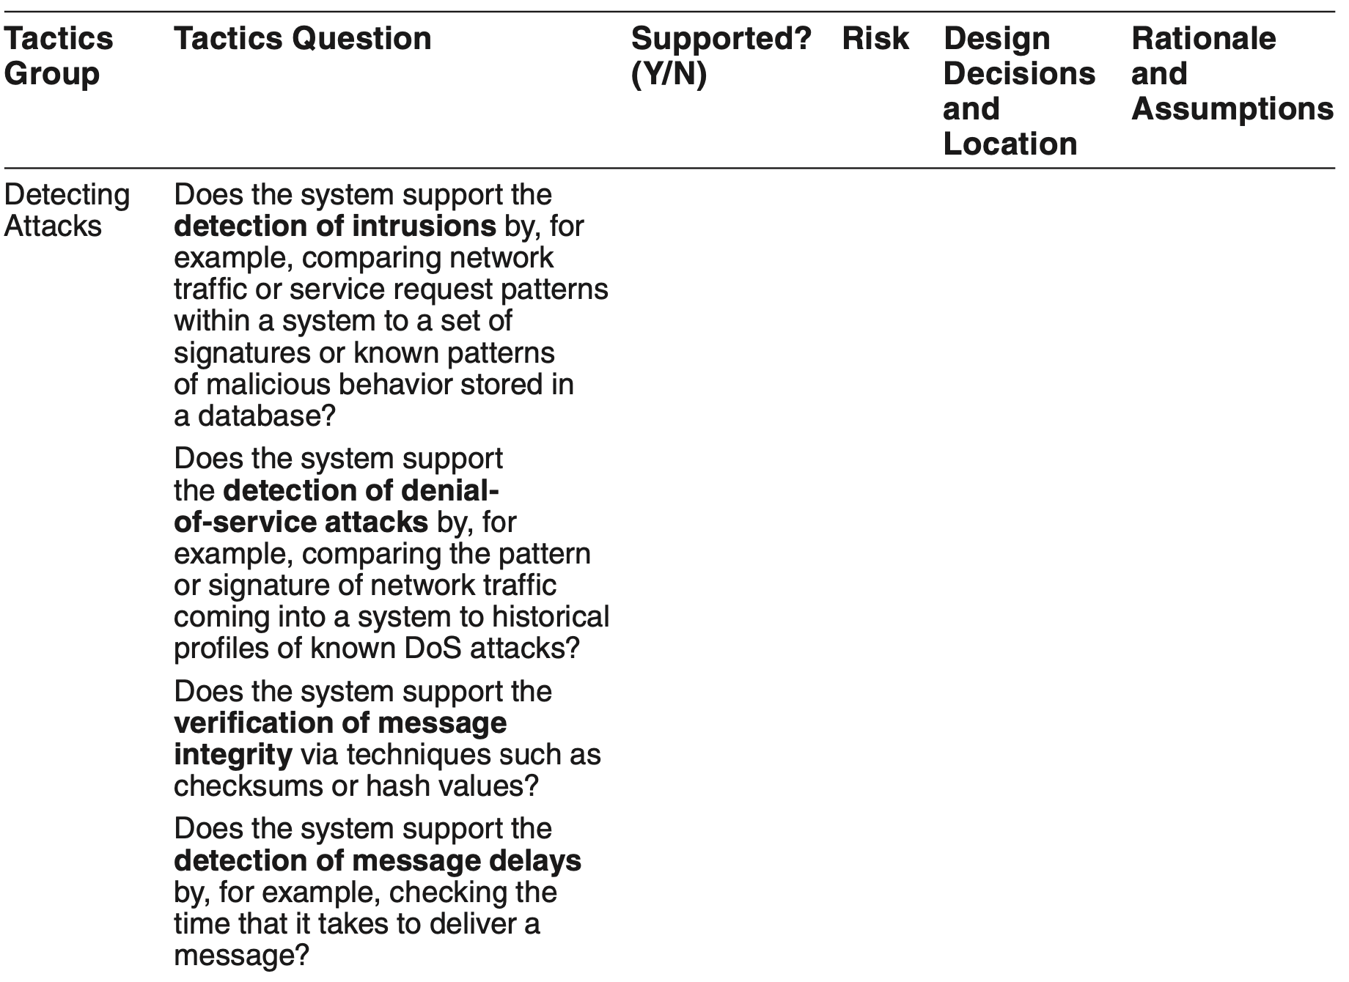
Tactics-Based Questionnaire for Security

Slide 19
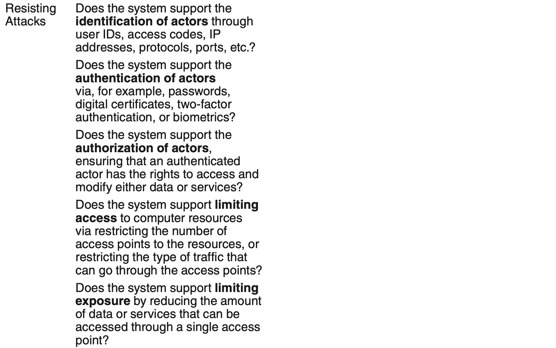
Tactics-Based Questionnaire for Security

Slide 20
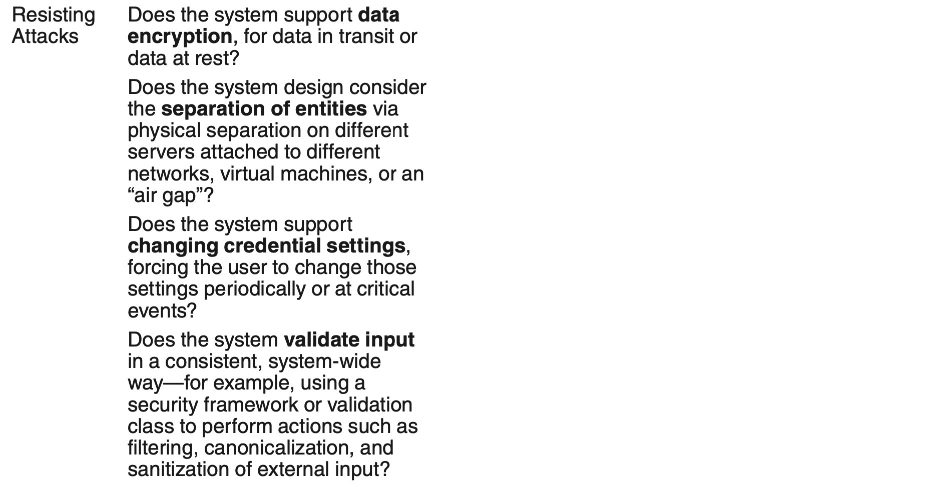
Tactics-Based Questionnaire for Security

Slide 21
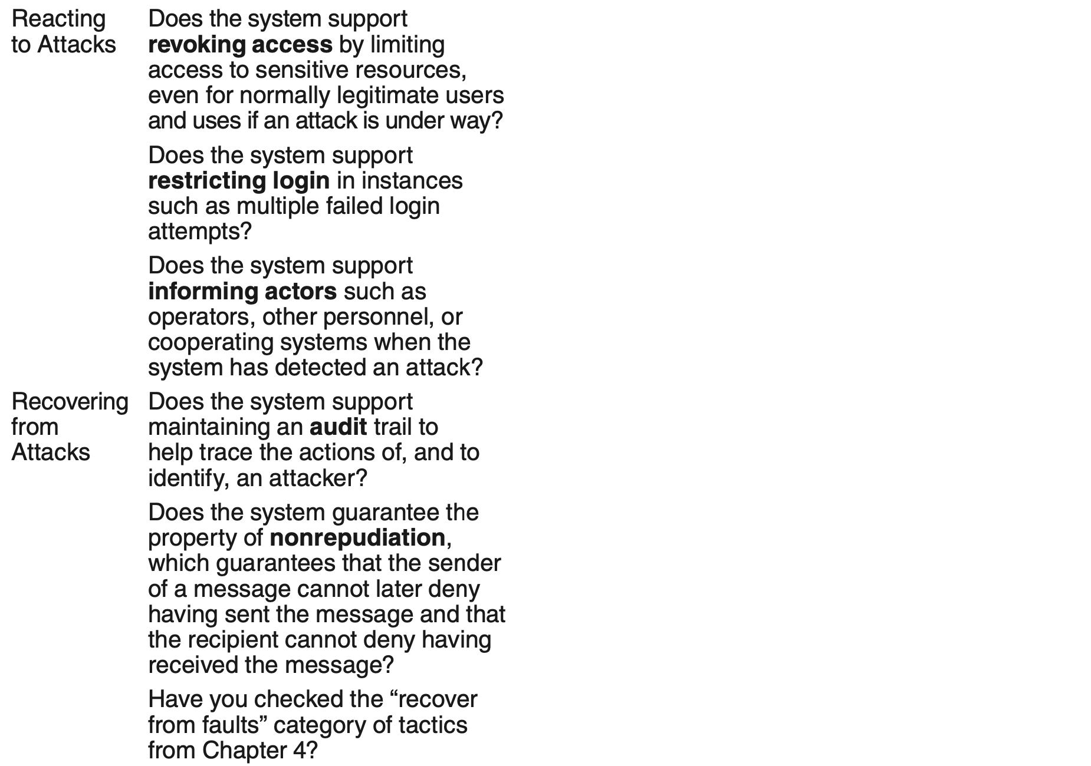
Tactics-Based Questionnaire for Security

Slide 22
Intercepting Validator Pattern for Security
This pattern inserts a software element—a wrapper—between the source and the destination of messages.
This approach assumes greater importance when the source of the messages is outside the system.
The most common responsibility of this pattern is to implement the verify message integrity tactic, but it can also incorporate tactics such as detect intrusion and detect service denial, or detect message delivery anomalies.

Slide 23
Intercepting Validator Pattern Benefits
Benefits:
Depending on the specific validator that you create and deploy, this pattern can cover most of the waterfront of the “detect attack” category of tactics, all in one package.

Slide 24
Intercepting Validator Pattern Tradeoffs
Tradeoffs:
As always, introducing an intermediary exacts a performance price.
Intrusion patterns change and evolve over time, so this component must be kept up-to-date so that it maintains its effectiveness. This imposes a maintenance obligation on the organization responsible for the system.

Slide 25
Intrusion Prevention System Pattern
An intrusion prevention system (IPS) is a standalone element whose main purpose is to identify and analyze any suspicious activity.
If the activity is deemed acceptable, it is allowed. Conversely, if it is suspicious, the activity is prevented and reported.

Slide 26
Intrusion Prevention System Pattern Benefits
These systems often encompass most of the “detect attacks” and “react to attacks” tactics.

Slide 27
Intrusion Prevention System Pattern Tradeoffs
The patterns of activity that an IPS looks for change and evolve over time, so the patterns database must be constantly updated.
Systems employing an IPS incur a performance cost.
IPSs are available as commercial off-the-shelf components, which makes them unnecessary to develop but perhaps not entirely suited to a specific application.

Slide 28
Summary
Attacks against a system can be characterized as attacks against the confidentiality, integrity, or availability of a system or its data.
This leads to many of the tactics used to achieve security. Identifying, authenticating, and authorizing actors are tactics intended to determine which users or systems are entitled to what kind of access to a system.
No security tactic is foolproof and systems will be compromised. Hence, tactics exist to detect an attack, limit the spread of any attack, and to react and recover from an attack.

